Slide 1
CS 106A, Lecture 17 2D Arrays and Images
suggested reading:
Java Ch. 11.6-11.7

Slide 2




HW5:
ImageShop
We are here
Practice
2D Arrays
Arrays
Midterm!
The River of Java

Slide 3
Plan for Today
Recap: Arrays
2D Arrays
Images as 2D Arrays
Announcements
Modifying Images
Practice: Brighten, Grayscale, Shrink

Slide 4
Plan for Today
Recap: Arrays
2D Arrays
Images as 2D Arrays
Announcements
Modifying Images
Practice: Brighten, Grayscale, Shrink

Slide 5
From Last Time: Arrays
A new variable type that is an object that represents an ordered, homogeneous list of data.
Arrays have many elements that you can access using indices
index | 0 | 1 | 2 | 3 | 4 | 5 | 6 | 7 | 8 | 9
value | 12 | 49 | -2 | 26 | 5 | 17 | -6 | 84 | 72 | 3
length = 10
element 0
element 4
element 9
Notes:
Indexed just like strings!

Slide 6
Creating an Array
type[] name = new type[length];
int[] numbers = new int[5];
index | 0 | 1 | 2 | 3 | 4
value | 0 | 0 | 0 | 0 | 0
Notes:
5 boxes, each contains an int

Slide 7
Creating an Array
Sometimes, we want to hardcode the elements of an array.
Luckily, Java has a special syntax for initializing arrays to hardcoded numbers.
type[] name = { elements };
// Java infers the array length
int[] numbers = {5, 32, 12, 2, 1, -1, 9};

Slide 8
Accessing Data In An Array
name[index] // get element at index
Like Strings, indices go from 0 to the array's length - 1.
for (int i = 0; i < 7; i++) {
println(numbers[i]);
}
println(numbers[9]); // exception
println(numbers[-1]); // exception
index | 0 | 1 | 2 | 3 | 4 | 5 | 6
value | 0 | 1 | 2 | 3 | 4 | 5 | 6
Notes:
The same as charAt, but for arrays

Slide 9
Putting Data In An Array
name[index] = value; // set element at index
Like Strings, indices go from 0 to the array's length - 1.
int[] numbers = new int[7];
for (int i = 0; i < 7; i++) {
numbers[i] = i;
}
numbers[8] = 2; // exception
numbers[-1] = 5; // exception
index | 0 | 1 | 2 | 3 | 4 | 5 | 6
value | 0 | 1 | 2 | 3 | 4 | 5 | 6
Notes:
Couldn’t do this with Strings!

Slide 10
Array Length
Similar to a String, you can get the length of an array by saying
myArray.length
Note that there are no parentheses at the end!

Slide 11
Arrays + For Loops = ❤️
Just like with Strings, we can use an array’s length, along with its indices, to perform cool operations.
For instance, we can read in numbers from the user:
int length = readInt("# of numbers? ");
int[] numbers = new int[length];
for (int i = 0; i < numbers.length; i++) {
numbers[i] = readInt("Elem " + i + ": ");
}
Notes:
Cumulative sum

Slide 12
Arrays + For Loops = ❤️
Just like with Strings, we can use an array’s length, along with its indices, to perform cool operations.
For instance, we can sum up all of an array’s elements.
int sum = 0;
for (int i = 0; i < numbers.length; i++) {
sum += numbers[i];
}
println(sum);
Notes:
Cumulative sum

Slide 13
Limitations of Arrays
An array’s length is fixed. You cannot resize an existing array:
int[] a = new int[4];
a.length = 10; // error
You cannot compare arrays with == or equals :
int[] a1 = {42, -7, 1, 15};
int[] a2 = {42, -7, 1, 15};
if (a1 == a2) { ... } // false!
if (a1.equals(a2)) { ... } // false!
An array does not know how to print itself:
println(a1); // [I@98f8c4]
Notes:
Just like how we can’t do much with chars – but luckily, there are Character methods! Same thing for Arrays.

Slide 14
Arrays Methods To The Rescue!
The class Arrays in package java.util has useful methods for manipulating arrays:
Method name | Description
Arrays.binarySearch(array, value) | returns the index of the given value in a sorted array (or < 0 if not found)
Arrays.copyOf(array, length) | returns a new copy of array of given length
Arrays.equals(array1, array2) | returns true if the two arrays contain same elements in the same order
Arrays.fill(array, value); | sets every element to the given value
Arrays.sort(array); | arranges the elements into sorted order
Arrays.toString(array) | returns a string representing the array, such as "[10, 30, -25, 17]"
Notes:
We’ll see more of these later.

Slide 15
Plan for Today
Recap: Arrays
2D Arrays
Images as 2D Arrays
Announcements
Modifying Images
Practice: Brighten, Grayscale, Shrink

Slide 16

The Matrix
Image used under “fair use” for educational purposes.
Source: https://www.themarysue.com/decoding-the-transgender-matrix-the-matrix-as-a-transgender-coming-out-story/

Slide 17
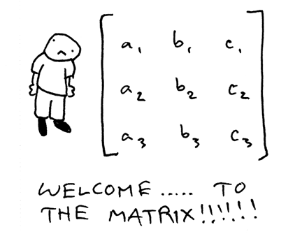
2D Arrays (“Matrices”)

Slide 18
2D Arrays
type[][] name = new type[rows][columns];
int[][] a = new int[3][5];
 | 0 | 1 | 2 | 3 | 4
0 | a[0][0] | a[0][1] | a[0][2] | a[0][3] | a[0][4]
1 | a[1][0] | a[1][1] | a[1][2] | a[1][3] | a[1][4]
2 | a[2][0] | a[2][1] | a[2][2] | a[2][3] | a[2][4]

Slide 19
Manipulating 2D Arrays
name[row][col] // get element at row,col
name[row][col] = value; // set element at row,col

Slide 20
2D arrays are arrays of arrays!

Slide 21
2D Arrays = Arrays of Arrays!
int[][] a = new int[3][4];
a[0][0] | a[0][1] | a[0][2] | a[0][3]
a[1][0] | a[1][1] | a[1][2] | a[1][3]
a[2][0] | a[2][1] | a[2][2] | a[2][3]

Slide 22
2D Arrays = Arrays of Arrays!
A 2D array is an array where every element is itself an array.
int[] a = new int[3];
int[][] a = new int[3][4];
“array of” int
“array of” int[]

Slide 23
2D Arrays = Arrays of Arrays!
A 2D array is an array where every element is itself an array.
int[][] a = new int[3][4];
...
int x = a[1][1]; // int at position (1, 1)
int[] firstRow = a[0]; // 1D array!
// NOTE: no way to get a single column ☹

Slide 24
2D Array Dimensions
How do we get the number of rows of a 2D array using the length property? How about the number of columns?
a[0][0] | a[0][1] | a[0][2] | a[0][3]
a[1][0] | a[1][1] | a[1][2] | a[1][3]
a[2][0] | a[2][1] | a[2][2] | a[2][3]

Slide 25
2D Array Dimensions
You can get the number of rows in a 2D array by saying:
arr.length // # rows in our 2D array
Since the length of each row is the same, you can get the number of columns in a 2D array by saying:
arr[0].length // # entries in row 0 ( = # cols)

Slide 26
2D Arrays + For Loops = ❤️
We can use double for-loops to loop over each row, and then each column, in a 2D array.
int[][] arr = ...
for (int row = 0; row < arr.length; row++) {
for (int col = 0; col < arr[0].length; col++) {
// do something with arr[row][col];
}
}
 | 0 | 1 | 2 | 3
0 | 75 | 61 | 83 | 71
1 | 94 | 89 | 98 | 91
2 | 63 | 54 | 51 | 49
“row-major” order

Slide 27
Practice: 2D Arrays
Q: What is the array state after the code below?
int[] a = new int[4][3];
... // fill with data at right
for (int r = 1; r < 4; r++) {
for (int c = 0; c < 3; c++) {
a[r][c] += a[r - 1][c];
}
} // A. B. C. D.
r\c | 0 | 1 | 2
0 | 1 | 2 | 3
1 | 1 | 2 | 3
2 | 1 | 2 | 3
3 | 1 | 2 | 3
 | 0 | 1 | 2
0 | 1 | 3 | 5
1 | 1 | 3 | 5
2 | 1 | 3 | 5
3 | 1 | 3 | 5
 | 0 | 1 | 2
0 | 1 | 3 | 6
1 | 1 | 3 | 6
2 | 1 | 3 | 6
3 | 1 | 3 | 6
 | 0 | 1 | 2
0 | 1 | 2 | 3
1 | 2 | 4 | 6
2 | 2 | 4 | 6
3 | 2 | 4 | 6
 | 0 | 1 | 2
0 | 1 | 2 | 3
1 | 2 | 4 | 6
2 | 3 | 6 | 9
3 | 4 | 8 | 12
Notes:
D

Slide 28
Limitations of 2D Arrays
Unlike 1D arrays, you cannot compare 2D arrays with Arrays.equals. You must use Arrays.deepEquals.
int[][] a1 = ...
int[][] a2 = ...
if (Arrays.deepEquals(a1, a2)) { ... }
A 2D array does not know how to print itself:
int[][] a = new int[rows][cols];
println(a); // [[I@8cf420
println(Arrays.toString(a)); // [[I@6b3f44,[I@32c2a8]...
// [[0, 1, 2, 3, 4], [1, 2, ...
println(Arrays.deepToString(a));
Notes:
Just like how we can’t do much with chars – but luckily, there are Character methods! Same thing for Arrays.

Slide 29
Summary: 2D Arrays
Make a new 2D array
type[][] name = new type[rows][columns];
Get and set values using bracket notation
name[row][col] // get elem at row,col
name[row][col] = value; // set elem at row,col
Get the number of rows and columns
arr.length // # rows
arr[0].length // # columns
Iterate over a 2D array using a double for-loop
for (int row = 0; row < arr.length; row++) {
for (int col = 0; col < arr[0].length; col++) {
// do something with arr[row][col];
}
}

Slide 30
Plan for Today
Recap: Arrays
2D Arrays
Images as 2D Arrays
Announcements
Modifying Images
Practice: Brighten, Grayscale, Shrink

Slide 31

Images
Images are just grids (2D arrays!) of pixels! Pixels are just integer values from 0-255.

Slide 32
Images as 2D Arrays
We can get a GImage as a 2D array of pixels.
GImage img = new GImage(“res/daisy.jpg”);
int[][] pixels = img.getPixelArray();
int pixel = pixels[0][0]; // top-left pixel
Notes:
How do you modify the pixels?

Slide 33
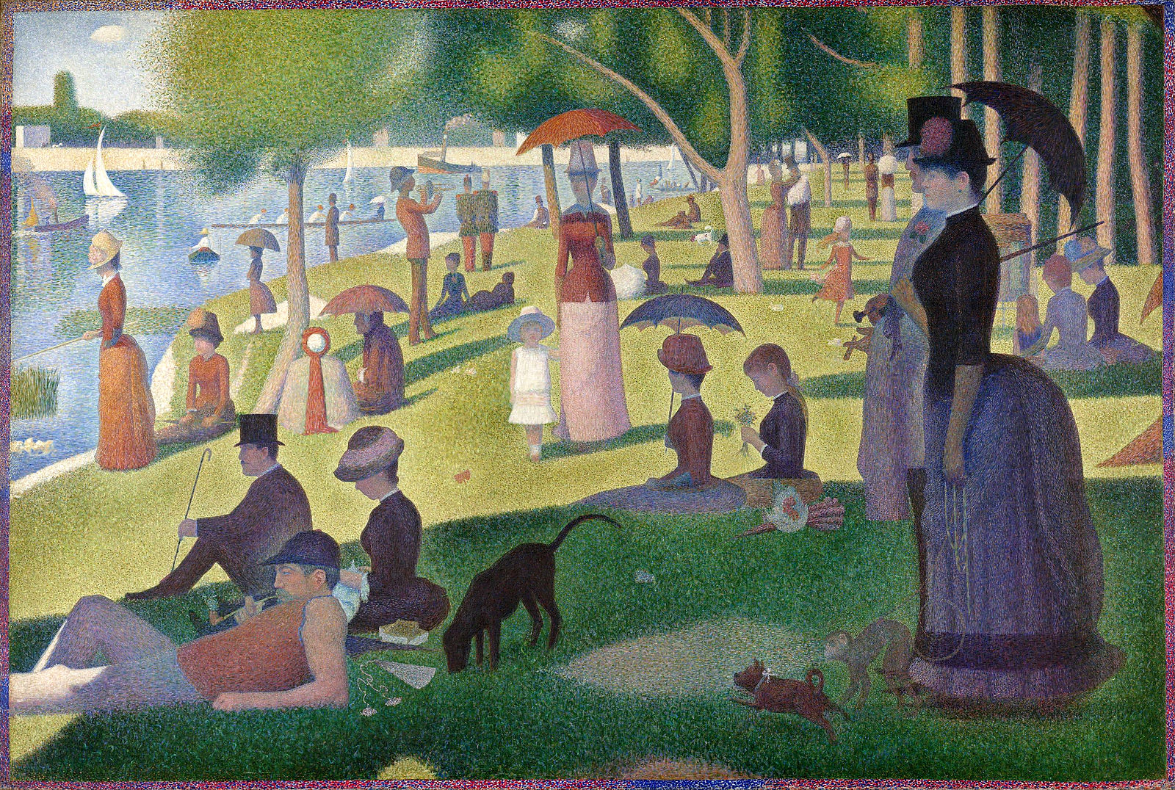
Example: Pointillism
Pointillism is an art style where many small dots of color are combined to make a larger image.
A Sunday on La Grande Jatte, Georges Seurat

Slide 34
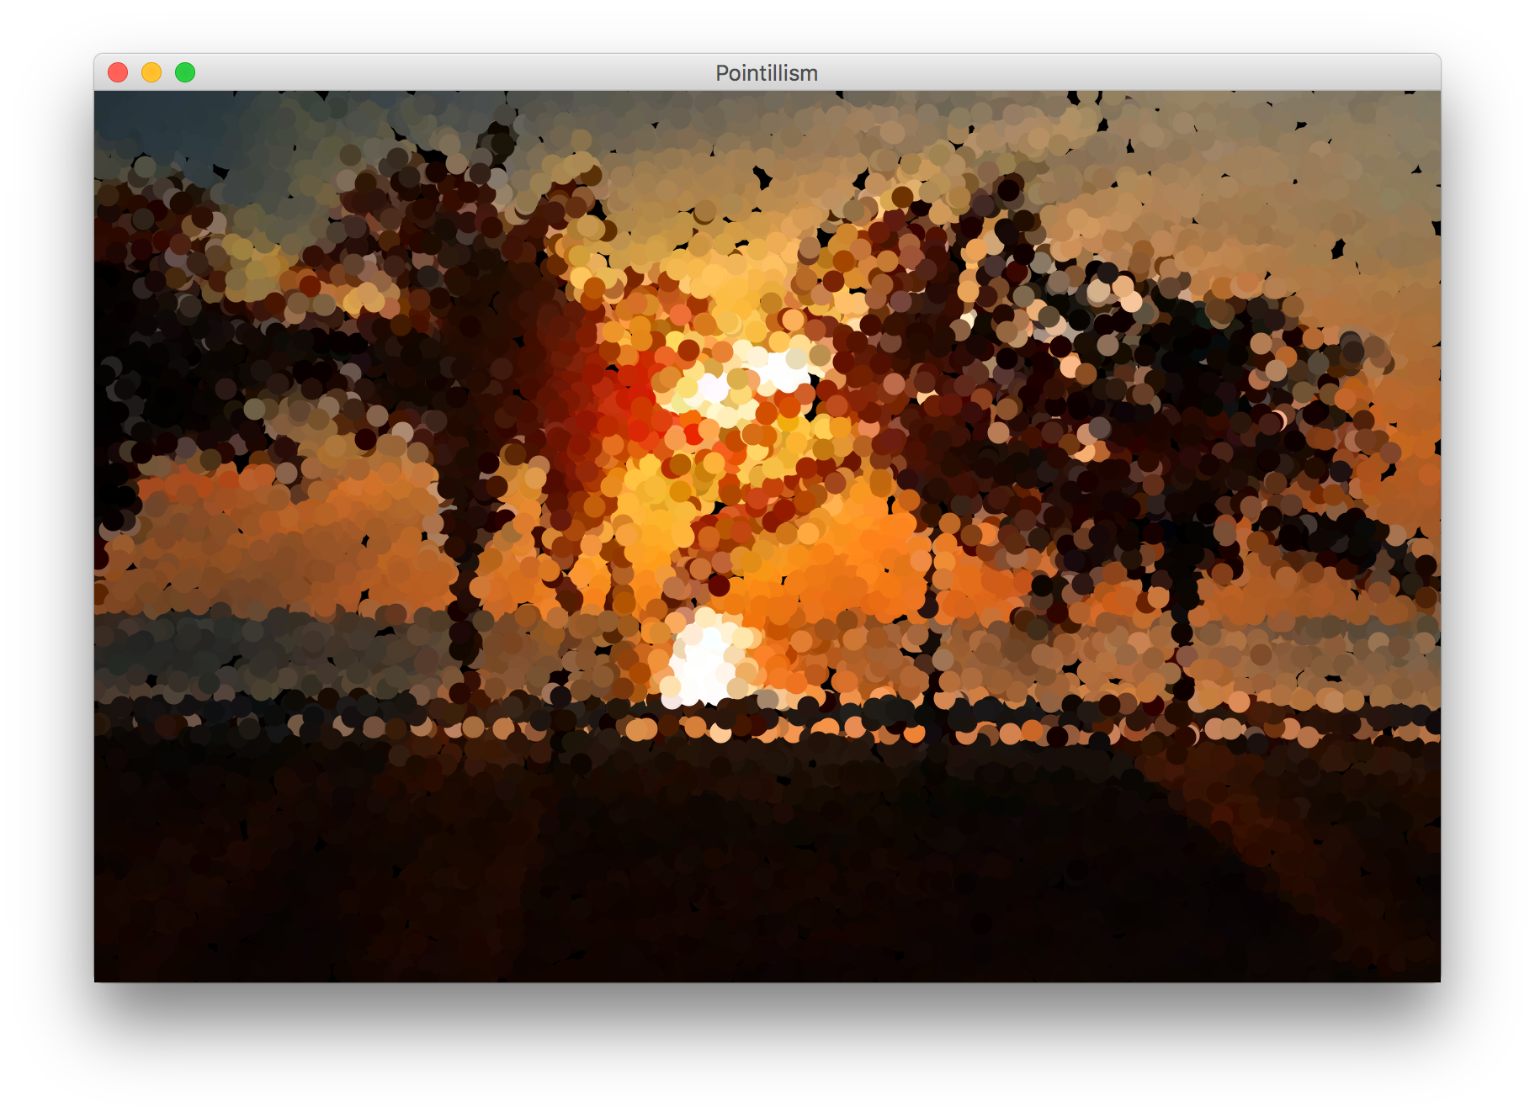

Example: Pointillism
Pointillism is an art style where many small dots of color are combined to make a larger image.

Slide 35
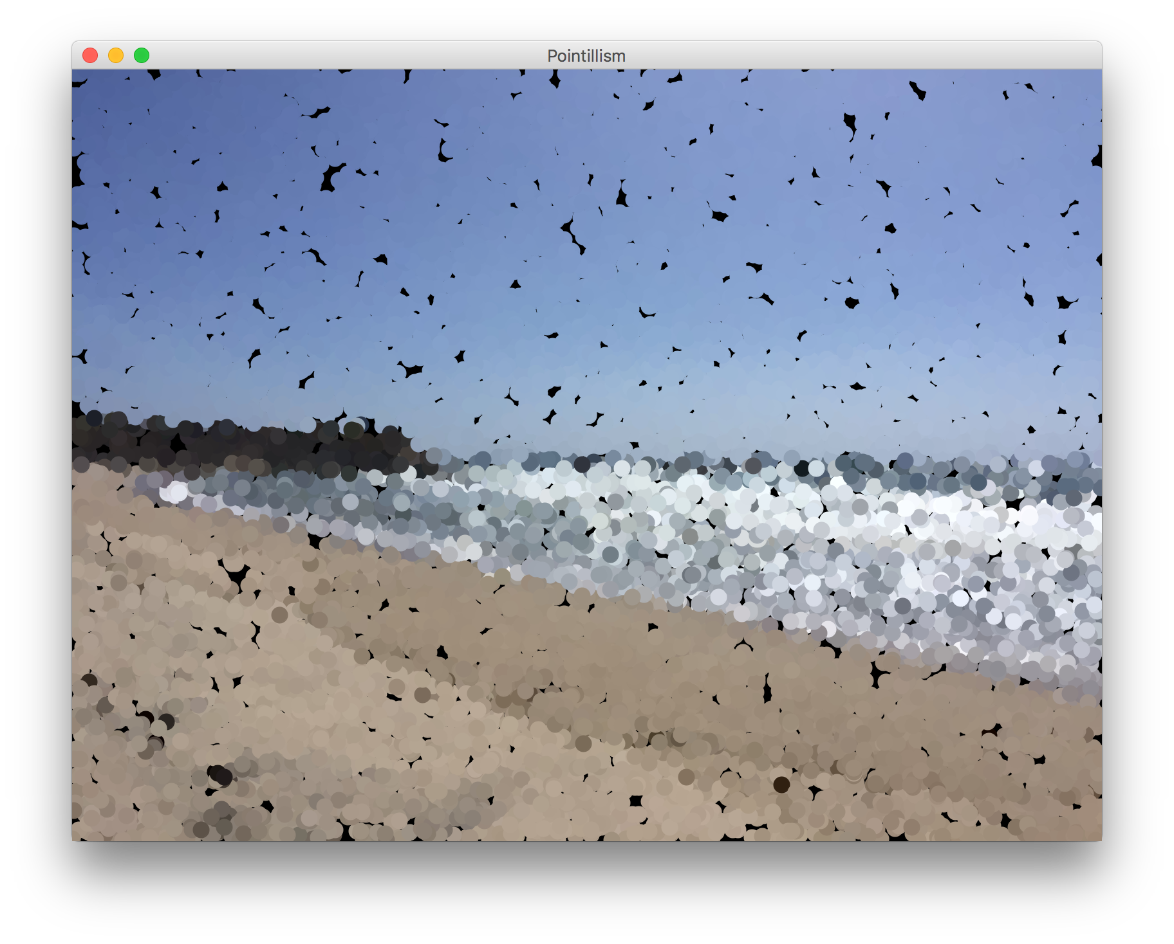

Example: Pointillism
Pointillism is an art style where many small dots of color are combined to make a larger image.

Slide 36
Example: Pointillism
Pointillism is an art style where many small dots of color are combined to make a larger image.
Repeat many times:
Pick a random pixel from an image
Find the pixel’s color
“Paint” a large brush stroke of that color in the corresponding location

Slide 37
Example: Pointillism

Slide 38
Example: Pointillism
c = 36
r = 46

Slide 39
Example: Pointillism
c = 36
r = 46

Slide 40
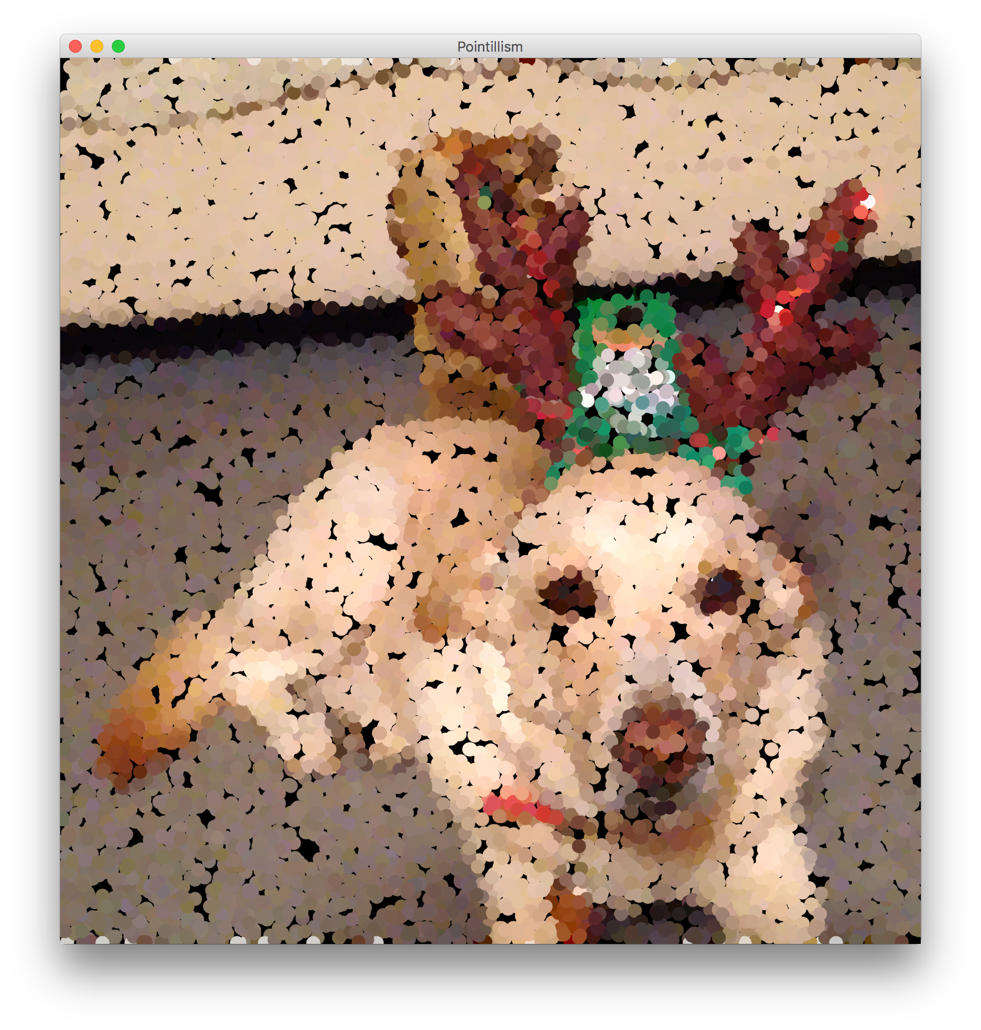
Example: Pointillism

Slide 41
Example: Pointillism
GImage daisy = new GImage(“res/daisy.jpg”);
int[][] pixels = daisy.getPixelArray();
int rows = pixels.length;
int cols = pixels[0].length;
for (int i = 0; I < NUM_SAMPLES; i++) {
int c = RandomGenerator.getInstance().nextInt(cols);
int r = RandomGenerator.getInstance().nextInt(rows);
int pixel = pixels[r][c];
Color color = new Color(pixel);
addColoredCircle(r, c, color);
}

Slide 42
Example: Pointillism
GImage daisy = new GImage(“res/daisy.jpg”);
int[][] pixels = daisy.getPixelArray();
int rows = pixels.length;
int cols = pixels[0].length;
for (int i = 0; I < NUM_SAMPLES; i++) {
int c = RandomGenerator.getInstance().nextInt(cols);
int r = RandomGenerator.getInstance().nextInt(rows);
int pixel = pixels[r][c];
Color color = new Color(pixel);
addColoredCircle(r, c, color);
}

Slide 43
Example: Pointillism
GImage daisy = new GImage(“res/daisy.jpg”);
int[][] pixels = daisy.getPixelArray();
int rows = pixels.length;
int cols = pixels[0].length;
for (int i = 0; I < NUM_SAMPLES; i++) {
int c = RandomGenerator.getInstance().nextInt(cols);
int r = RandomGenerator.getInstance().nextInt(rows);
int pixel = pixels[r][c];
Color color = new Color(pixel);
addColoredCircle(r, c, color);
}

Slide 44
Example: Pointillism
GImage daisy = new GImage(“res/daisy.jpg”);
int[][] pixels = daisy.getPixelArray();
int rows = pixels.length;
int cols = pixels[0].length;
for (int i = 0; I < NUM_SAMPLES; i++) {
int c = RandomGenerator.getInstance().nextInt(cols);
int r = RandomGenerator.getInstance().nextInt(rows);
int pixel = pixels[r][c];
Color color = new Color(pixel);
addColoredCircle(r, c, color);
}

Slide 45
Example: Pointillism
GImage daisy = new GImage(“res/daisy.jpg”);
int[][] pixels = daisy.getPixelArray();
int rows = pixels.length;
int cols = pixels[0].length;
for (int i = 0; I < NUM_SAMPLES; i++) {
int c = RandomGenerator.getInstance().nextInt(cols);
int r = RandomGenerator.getInstance().nextInt(rows);
int pixel = pixels[r][c];
Color color = new Color(pixel);
addColoredCircle(r, c, color);
}

Slide 46
Example: Pointillism
GImage daisy = new GImage(“res/daisy.jpg”);
int[][] pixels = daisy.getPixelArray();
int rows = pixels.length;
int cols = pixels[0].length;
for (int i = 0; I < NUM_SAMPLES; i++) {
int c = RandomGenerator.getInstance().nextInt(cols);
int r = RandomGenerator.getInstance().nextInt(rows);
int pixel = pixels[r][c];
Color color = new Color(pixel);
addColoredCircle(r, c, color);
}

Slide 47
Example: Pointillism
GImage daisy = new GImage(“res/daisy.jpg”);
int[][] pixels = daisy.getPixelArray();
int rows = pixels.length;
int cols = pixels[0].length;
for (int i = 0; I < NUM_SAMPLES; i++) {
int c = RandomGenerator.getInstance().nextInt(cols);
int r = RandomGenerator.getInstance().nextInt(rows);
int pixel = pixels[r][c];
Color color = new Color(pixel);
addColoredCircle(r, c, color);
}

Slide 48
Example: Pointillism
// Assume canvas is exactly image size
private void addColoredCircle(int r, int c, Color c) {
double size = CIRCLE_RADIUS * 2;
GOval circle = new GOval(size, size);
circle.setFilled(true);
circle.setColor(c);
add(oval, c - CIRCLE_RADIUS, r – CIRCLE_RADIUS);
}
Notes:
Demo!

Slide 49
Plan for Today
Recap: Arrays
2D Arrays
Images as 2D Arrays
Announcements
Modifying Images
Practice: Brighten, Grayscale, Shrink

Slide 50
Anonymous Questions
Out of curiosity, do you also happen to like broccoli?
Can I see more Daisy?
A slingshot may help you with candy delivery (your accuracy tends to drop off after ~10 rows). Make sure its a low-powered slingshot, though, as I don't think students would appreciate being pelted with candy at high speeds.

Slide 51
Plan for Today
Recap: Arrays
2D Arrays
Images as 2D Arrays
Announcements
Modifying Images
Practice: Brighten, Grayscale, Shrink

Slide 52
Red, Green and Blue in one int?
Images encode the R, G, and B values of a pixel into a single integer between 0 and 255. You can convert between this pixel value and the individual RGB values.
int[][] pixels = image.getPixelArray();
int px = pixels[0][0];
int red = GImage.getRed(px);
int green = GImage.getGreen(px);
int blue = GImage.getBlue(px);

Slide 53
Creating New Pixels
Images encode the R, G, and B values of a pixel into a single integer between 0 and 255. You can convert between this pixel value and the individual RGB values.
You can also create pixels with your own RGB values.
int r = ...
int g = ...
int b = ...
int pixel = GImage.createRGBPixel(r, g, b);

Slide 54
Images as 2D Arrays
We can get a GImage as a 2D array of pixels, and modify it any way we want. Then, we can create a new GImage with the modified pixels.
GImage img = new GImage(“res/daisy.jpg”);
int[][] pixels = img.getPixelArray();
... (modify pixels)
img.setPixelArray(pixels); // update image
// or make a new GImage
GImage newImg = new GImage(pixels);

Slide 55
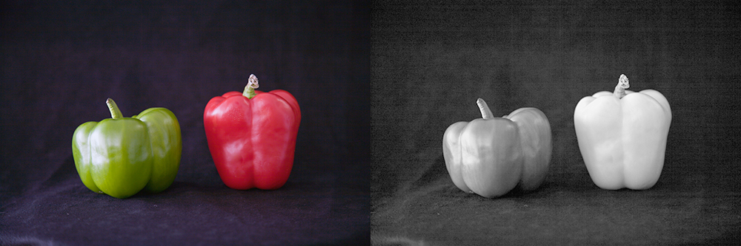
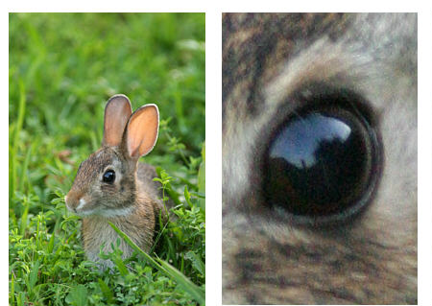
Modifying Image Pixels
There are many cool image algorithms based around modifying individual pixels in an image: grayscale, brighten, normalize, remove red-eye…
grayscale
zoom

Slide 56
GImage Pixel Methods
GImage img = new GImage("res/daisy.jpg");
Method name | Description
img.getPixelArray() | returns pixels as 2D array of ints, where each int in the array contains all 3 of Red, Green, and Blue merged into a single integer
img.setPixelArray(array); | updates pixels using the given 2D array of ints
GImage.createRGBPixel(r, g, b) | returns an int that merges the given amounts of red, green and blue (each 0-255)
GImage.getRed(px) GImage.getGreen(px) GImage.getBlue(px) | returns the redness, greenness, or blueness of the given pixel as an integer from 0-255

Slide 57
Recap: Modifying Pixels
Extract pixel RGB colors with GImage.getRed/Blue/Green.
int red = GImage.getRed(pixels[0][0]); // 0-255
int green = GImage.getGreen(pixels[0][0]); // 0-255
int blue = GImage.getBlue(pixels[0][0]); // 0-255
Modify the color components for a given pixel.
red = 0; // remove redness
Combine the RGB back together into a single int.
pixels[0][0] = GImage.createRGBPixel(red, green, blue);
Update the image with your modified pixels when finished.
image.setPixelArray(pixels);

Slide 58
Changing Image Size
Destination image is same size → often modify array in place.
Destination image is different size → need a new array.
Example: Half the size of an image.
int[][] pixels = img.getPixelArray();
int[][] smaller = new int[pixels.length / 2]
[pixels[0].length / 2];
...
// set to be the pixels of ‘smaller’
img.setPixelArray(smaller);

Slide 59
Plan for Today
Recap: Arrays
2D Arrays
Images as 2D Arrays
Announcements
Modifying Images
Practice: Brighten, Grayscale, Shrink

Slide 60
Recap
Recap: Arrays
2D Arrays
Images as 2D Arrays
Announcements
Practice: Brighten
Practice: Grayscale
Practice: Shrink
Next time: more practice with arrays

